Slide 1
China’s First Dynasties

Slide 2
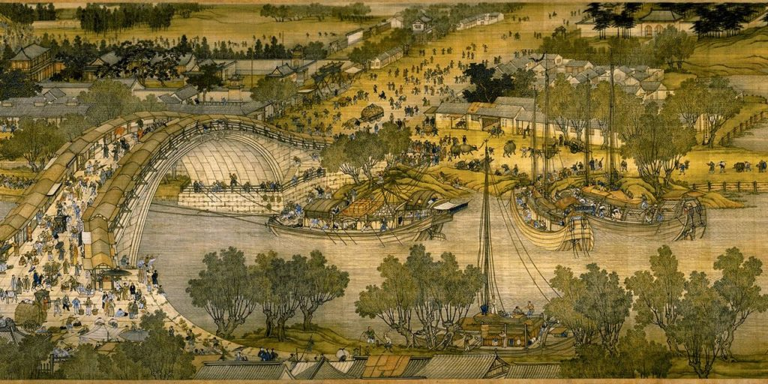
Xia Dynasty:
Real or Myth?
Yellow King Huang-ti emerged from tribal system
2697-2597 BCE: Ruled Shandong region
Created Chinese govt system
Invented musical instruments
Developed silk production
Instituted laws and customs
Developed medicine and agriculture
Buried in Shaanxi Province

Slide 3
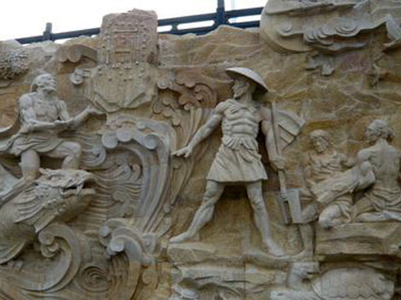
King Yao
Built palaces
Villages turned into cities
The FLOOD
Yellow River flooded every year
Appoints Gun to take care of it
Tried for 9 years
Created series of dykes
Eventually collapsed
Fired by King Yao’s successor King Shun

Slide 4
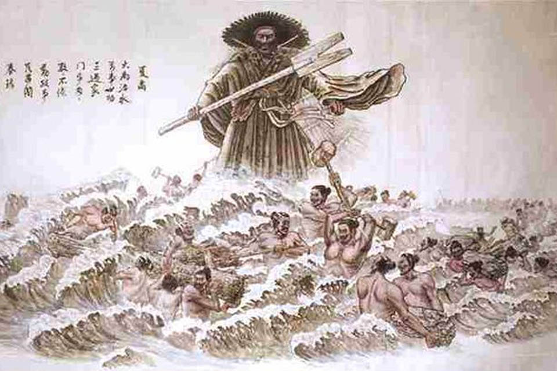
Yu the Great:
Son of Gun
Given task to stop flood
Worked with local tribes
Built canals that led water to the sea
13 year project
Never visited his home once
King Shun rewarded Yu by placing him in charge of the army
Conquered Sanmiao tribe
Declared heir to the throne
Divided country into 9 provinces

Slide 5
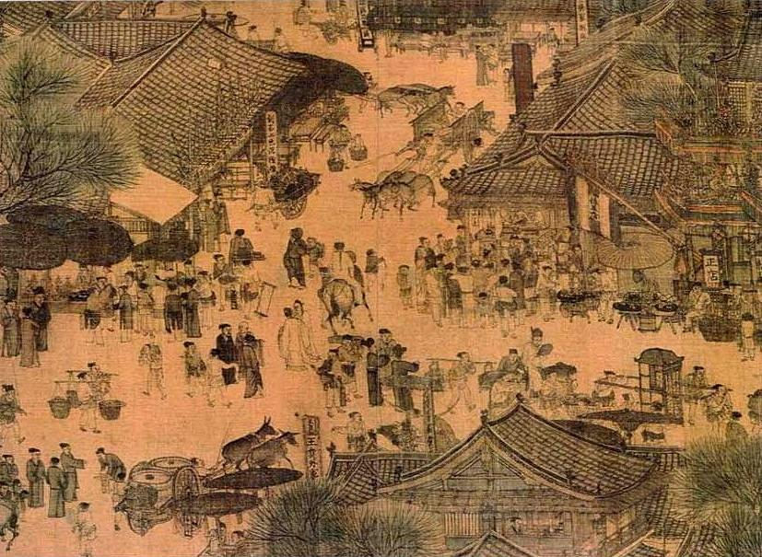
Yu’s son Qi named his successor
Initiated dynastic succession
Successors developed armor and rules of chivalry in battle
Began to decline under Kong Jia
King Jie: tyrant and lost mandate of heaven
Belief that the gods gave certain people the right to rule over others
Overthrown by Shang dynasty in 1675 BCE

Slide 6
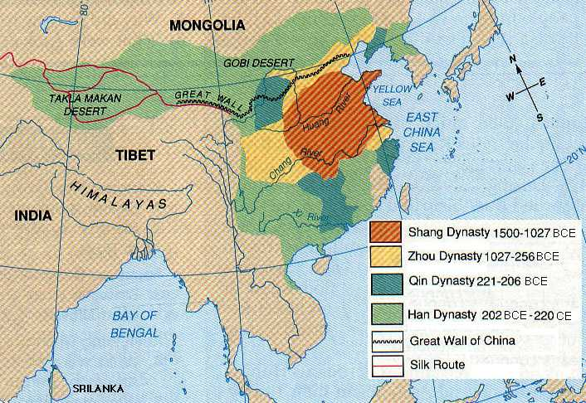

Slide 7
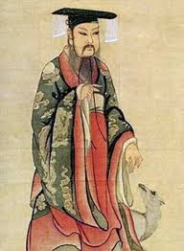
King Tang: 1675-1646 BCE
led a revolt against Xia
Battle of Mingtiao: Defeated Jie
Abolished excessive taxes
Kept a standing army of 1,000 troops
Lowered number of conscripts and amount of time served
Social programs for the poor
Specially marked gold coins issued to buy back children sold during famine

Slide 8
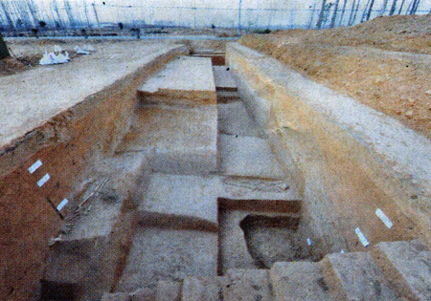
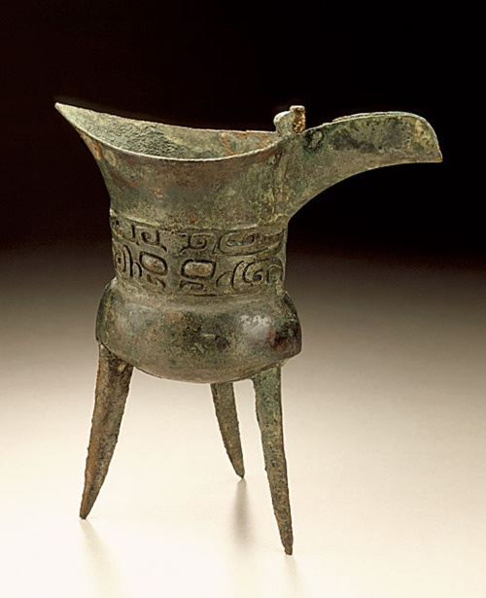
Erligang:
Uses hangtu (stamped earth) technique
32 ft high walls 65 ft thick
12,000 men, 10 years to build
Bronze foundries used to craft weapons and statues
Jadework
Bone workshops
Artisans created objects for ceremonial or decorative purposes

Slide 9
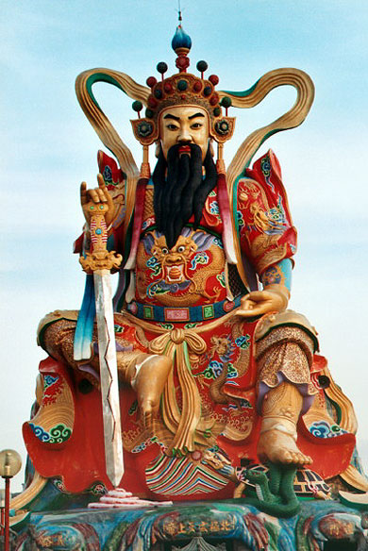
Religion:
worshipped many gods
Shangti: supreme god
Ancestor worship began out of need for intercessors on behalf of the people
Developed link between people and the king and the gods
Ritual practices developed to appease spirits of ancestors
King served as chief mediator between living and dead
Taoist religion developed

Slide 10
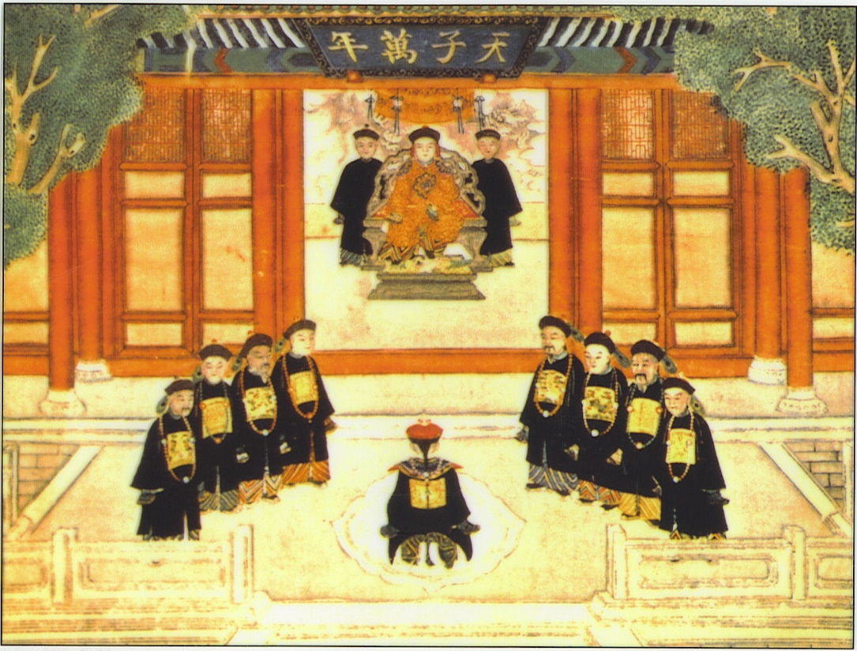
Mandate of Heaven:
Influenced dynastic cycle
One legitimate ruler of China
“Son of Heaven”
Blessing of the gods
Moral obligation to help people of China
Legitimized claim to throne
“Supernatural signs”
If ruler immoral, dynasty would fall
Traitor vs. rebel

Slide 11
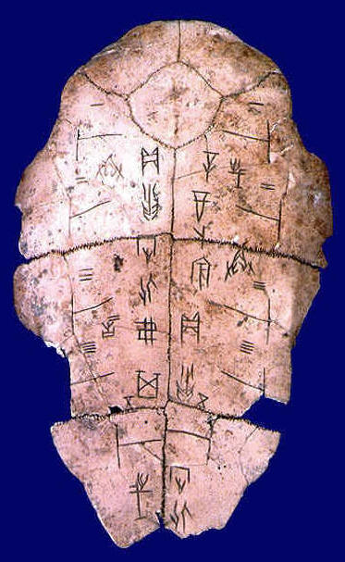
Calendar:
based on lunar and solar time
Wan-Nien: measured shadows to determine two solstices and two equinoxes
Proved that there are 365 days in a year
Oracle bones:
shells of turtles or animal bones used in divination
Led to development of writing
1250 BCE: 1st recognizable Chinese script
Oracle Scripts: accounts of eclipses and other celestial events
Development of odd and even numbers and principles of accounting

Slide 12
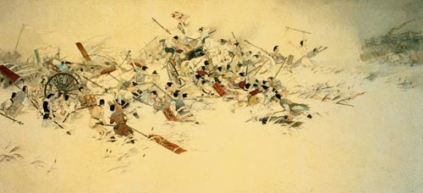
Angyang: capital of Shang
1300 BCE: separate states started to break off economically
King Wu Ding: 1250-1192 BCE
Height of advancement
Zhou/Xin King:
Spent most of his time with his concubine Daji
Heavily taxed people
Neglected duties of office
Overthrown by King Wu of Zhou province
1046 BCE: Battle of Muye

Slide 13
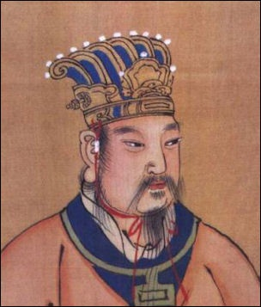
Zhou Dynasty 1046-226 BCE:
Western Zhou 1122-771 BCE:
Independent State that acknowledged Shang
1045: Shang king commits suicide
Zhou king moves capital to Zengzhou
King dies; brother (Duke of Zhou) safeguards throne for young nephew
Duke of Zhou leads an expedition against Shang-dominate states
Forces them under control of Zhou

Slide 14
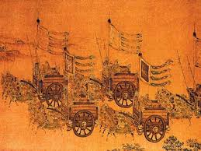
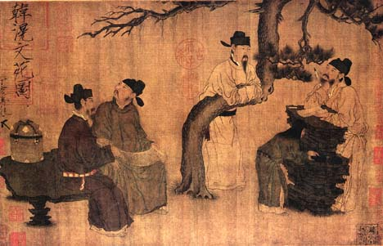
Political system:
Placed members of Zhou family in charge of former Shang states
Inter-married to consolidate power
Kingdom divided into principalities
Vassal prince owed:
loyalty to Zhou king
Render advice
Provide laborers
Provide soldiers and help lead on Zhou military campaigns

Slide 15
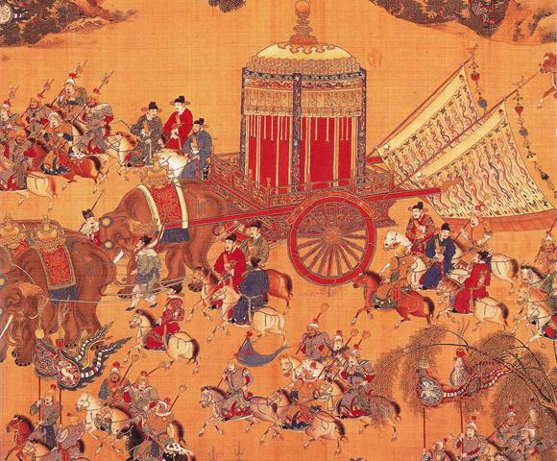
Principalities:
Subdivided into fiefs handed to relatives/followers of princes
Helped expand/stabilize borders
“Colonies”
Fortified frontier settlements
Act as bases that slowly incorporated “barbarians” into Zhou territory
Army:
Six Armies of the West
977 BCE: wiped out on campaign in Yangtze valley
Eight Armies of Zengzhou

Slide 16
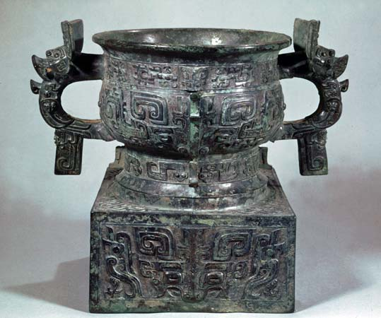
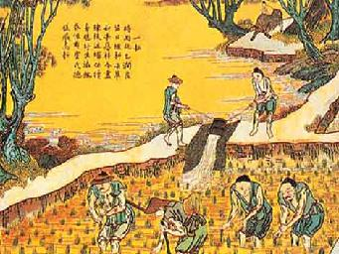
Early Zhou culture:
Adopted ritual and burial practices of Shang
Burial of chariots, horses, and charioteers in pits of nobility
Ceased use of oracle bones
Agriculture: rotated millet crops with soybean
Development of iron
Replaced bronze
Iron farming tools
Increased productivity

Slide 17
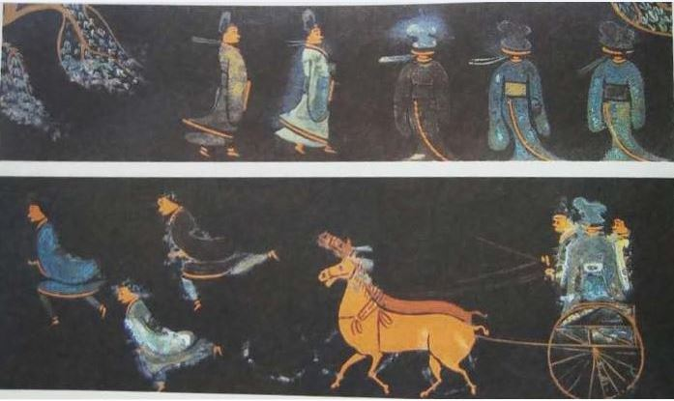
Decline:
Blood ties thinned
Loyalties fragmented
Principalities focused on own territory, not empire
771BCE: royal capital at Haojing was sacked by coalition of rebels and barbarians
Zhou forced to move East
Territorial princes became virtually independent

Slide 18
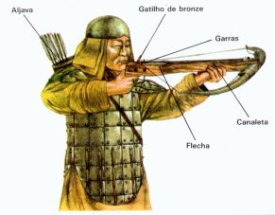
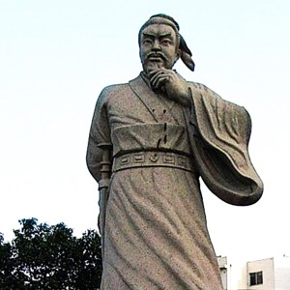
Eastern Zhou 771-256 BCE:
Kings too weak to control territorial princes
Infighting between principalities
Larger states emerged
Ultimately led to Warring States period
Permanent armies maintained
Art of War written by Sun Tzu
Cross-bow developed
Rise of professional generals
Active diplomacy
Rise of spies and assassinations
Northern walls built against steppe nomads

Slide 19
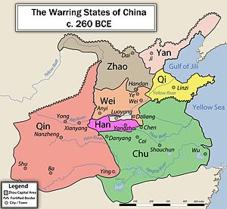
Fall of Zhou:
Shift to Warring States period where surviving states did not acknowledge Zhou king as their superior
256 BCE: Qin kingdom marches on Zhou capital
Annexed Zhou territory
221 BCE: Founded Qin dynasty
Became 1st Emperor of China

